Slide 1
Transformer based end-to-end Web Application Firewall (WAF) pipeline
Review-1
Batch Number : CDV_14
Under the Supervision of,
Mr. BAILAPPA BHOVI
Assistant Professor
School of Computer Science and Engineering
Presidency University
Roll Number | Student Name
20211CDV0062 20221CDV0050 20211CDV0024 | CHETHAS R VARSHITH RS ABDUL KALAM
Name of the Program: CDV-Computer Science & Technology (DEVOPS)
Name of the HoD: Dr. Pravinthraja S
Name of the Program Project Coordinator: Dr. H M Manjula
Name of the School Project Coordinators: Dr. Sampath A K , Dr. Geetha A

Slide 2
Problem Statement Number: SIH25172
Organization: Indian Space Research Organization (ISRO)
Category (Hardware / Software / Both) :Software
Problem Description:
Background Traditional Web Application Firewalls (WAFs) rely primarily on static, rule-based detection (e.g., MoD Security rules). These mechanisms struggle against zero-day exploits or never-seen-before attack patterns. Transformers, however, can learn complex request patterns from raw web traffic and detect anomalies without hard-coded signatures, offering a promising alternative. This challenge asks teams to build a complete pipeline from log ingestion → parsing → transformer-based training → real-time anomaly detection on a live web server. Detailed Description Participants will be provided with 3 (THREE) sample web application in war compressed format. They need to generate synthetic access log dataset representing benign requests only for the provided 03 applications. They shall use this data to further train the existing transformer models. They must implement a complete system that supports: Log Ingestion: • Collect access logs from the web server (Apache or Nginx). • Supports both batch ingestion (historical logs) and streaming ingestion (tailing live logs).
Parsing & Normalization: • Extract key fields (method, path, parameters, headers, payload, etc.). • Normalize/remove dynamic values (IDs, timestamps, tokens, etc.).

Slide 3
Problem Statement Number: SIH25172
Tokenization & Input Transformation: • Convert normalized requests into token sequences suitable for a Transformer-based model.
Model Training: • Train an open-source Transformer-based model. • Participants are free to select transformer architecture. • Training can happen before the grand finale.
Real-Time Inference & Live Detection: • Deploy the trained model alongside the sample app and integrate it with Apache or Nginx. • The WAF component must receive each incoming request in real time and detect any anomalous request. • Detections must run in non-blocking mode i.e multiple requests should be scanned simultaneously, without blocking each other or delaying normal traffic.
Continuous Updates: • Provide an automated mechanism to re-train or fine-tune the existing model on new benign traffic. • Update should be incremental, there should not be a need to retrain the model on full data, training will be done only on incremental data.
Demonstration: • Use the supplied web application to show live detection of malicious requests. • Participants will inject malicious payloads (e.g., via curl or script) to test detection. • Judges will provide payload, requests to be done during grand finale to detect accuracy and detection ratio.

Slide 4
Problem Statement Number: SIH25172
Expected Solution Ingestion: Batch and real-time ingestion of access logs (commonly used format by Apache/nginx).
Parser: Structured extraction, normalization.
Tokenizer: Prepares request sequence for Transformer.
Model Training: Transformer model trained on benign traffic.
Integration: Model integration into Apache/Nginx pipeline (via module, sidecar, or external micro service).
Non-Blocking Detection: Concurrent inference on real world traffic.
Continuous Update: Script / API for periodic retraining on incremental data only.
Demo: Live test of malicious input triggering detection log.

Slide 5
Content
Problem Statement
Objectives
Background and Related work for title Selection
Analysis of Problem Statement
Innovation or Novel Contributions
GitHub Link
Timeline of the Project
References

Slide 6
Problem Statement
Traditional Web Application Firewalls (WAFs) depend on static, rule-based detection mechanisms such as MoD Security rules.
These systems:
Fail to detect zero-day attacks
Require manual rule updates
Cannot adapt to new attack patterns
Generate high false positives
There is a need for an adaptive and intelligent WAF capable of detecting unknown and anomalous web requests in real time.

Slide 7
Objectives
Collect web access logs from Apache / Nginx
Support batch and real-time log ingestion
Parse and normalize HTTP requests
Convert requests into Transformer-compatible tokens
Train a Transformer model on benign traffic
Detect anomalous requests in real time
Enable incremental model updates
Demonstrate live detection of malicious requests

Slide 8
Background and Related work
Background
Traditional WAFs rely on signature-based detection
Ineffective against never-seen-before attacks
Increasing use of machine learning in cybersecurity
Related Work
Rule-based WAFs (Mod Security)
ML-based intrusion detection systems
Deep learning models for anomaly detection
Recent studies show Transformers outperform RNNs and CNNs in sequence learning

Slide 9
Analysis of Problem Statement
Problem Analysis
Web traffic is high-dimensional and dynamic
Attack patterns continuously evolve
Static rules cannot scale
Real-time detection must be non-blocking
Key Challenges
Log normalization
Real-time inference latency
Model generalization
Incremental learning without retraining

Slide 10
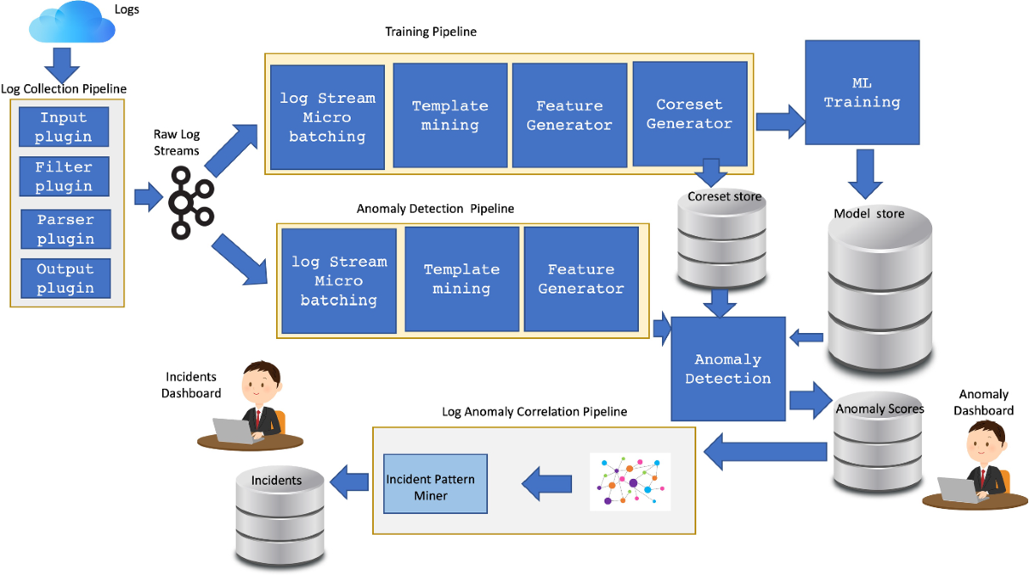
Architecture

Slide 11
Innovation or Novel Contributions
Novel Contributions
Transformer-based anomaly detection instead of signature matching
Training on benign traffic only
End-to-end pipeline from logs to live detection
Non-blocking, concurrent request analysis
Incremental fine-tuning using new benign data
Real-time deployment alongside web server

Slide 12
Github Link
The Github link provided should have public access permission.
GitHub Link : https://github.com/varshthrss/CDV_14_WEB_Pipeline

Slide 13
Timeline of the Project
Phase | Activity | Duration
Phase 1 | Literature survey & design | Week 1–2
Phase 2 | Log ingestion & parsing | Week 3–4
Phase 3 | Tokenization & model training | Week 5–6
Phase 4 | Real-time inference integration | Week 7–8
Phase 5 | Incremental learning | Week 9
Phase 6 | Testing & demo | Week 10
Phase 7 | Documentation & final review | Week 11–12

Slide 14
References (IEEE Paper format)
“Deep Learning for Anomaly Detection: A Survey.” IEEE Access, vol. 7, pp. 36315–36333, 2019.DOI: 10.1109/ACCESS.2019.2896884
“Outside the Closed World: On Using Machine Learning for Network Intrusion Detection.”IEEE Symposium on Security and Privacy, 2010.

Slide 15


